Slide 1
GRAPH DATABASE

Slide 2
What is a graph database?
A graph database is a collection of nodes (or vertices) and edges (or relationships). A node represents an entity (for example, a person or an organization) and an edge represents a relationship between the two nodes that it connects (for example, likes or friends). Both nodes and edges may have properties associated with them.

Slide 3
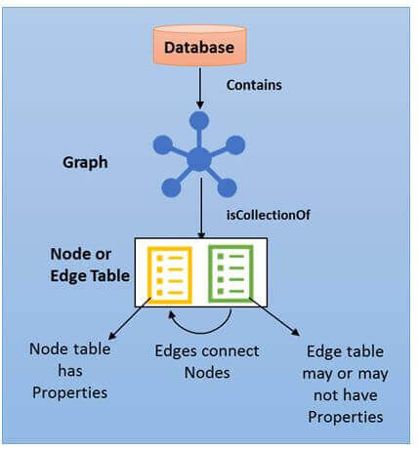
Architecture

Slide 4
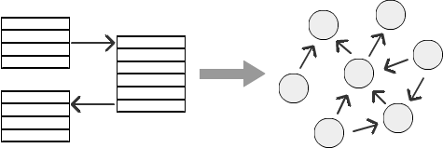
Why use a graph database?
To achieve high levels of performance and data reliability. Graph representation offers a convenient means of handling complex relationships and provides solution to many important problems and helps derive the results within the scope of the given context.

Slide 5
Where use a graph database?
It has the capability to influence various fields such as social networking, fraud detection, IT network analysis, social recommendations, product recommendation, and content recommendation.

Slide 6
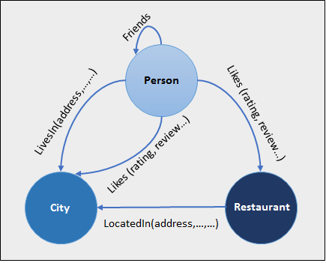
Scenario 1:Person_city_Restaurant Relationship

Slide 7
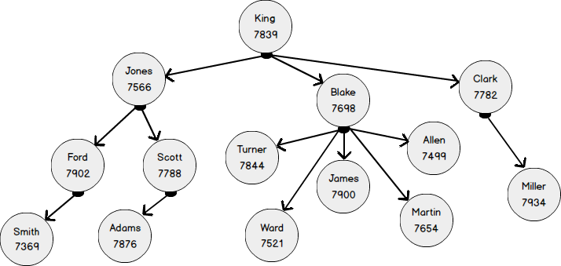
Scenario 2: Employee Manager Relationship

Slide 8
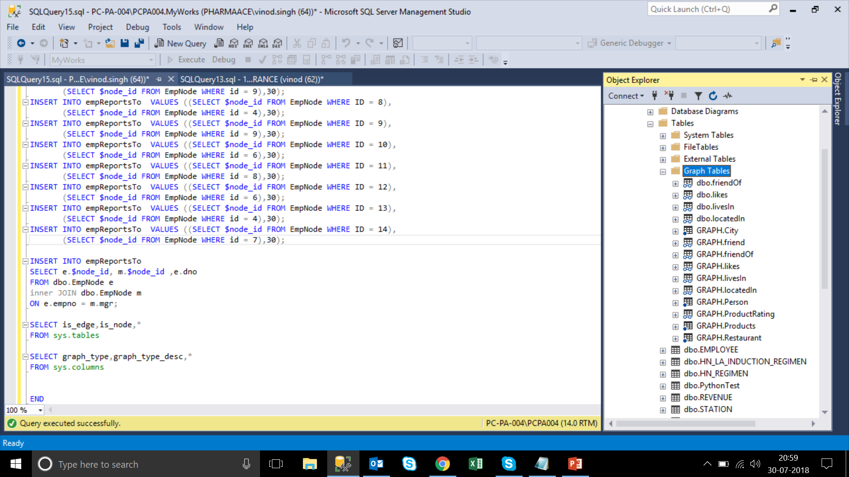
SSMS View
SELECT is_edge,is_node,* FROM sys.tables
SELECT graph_type,graph_type_desc,* FROM sys.columns

Slide 9
Limitation
No support for polymorphism
SQL supports only unidirectional mapping
Update on the edge columns is not allowed
Support for In-Memory OLTP objects is limited
System table, Temporary table, and Global Temporary tables are not supported
Table types and table variables are not declared as NODE or EDGE
Cross-database queries are not supported
There is no direct way or a wizard available to convert existing traditional database tables to graph

Slide 10
THANK YOU !!!

